Slide 2
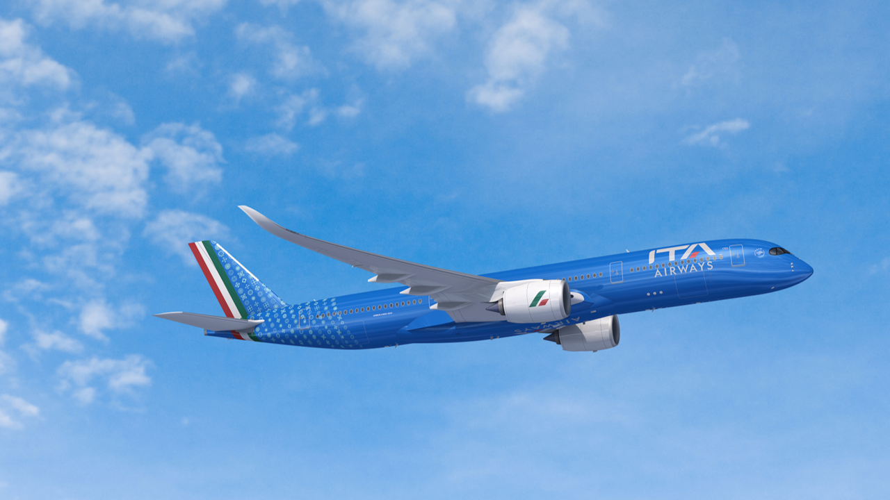
AI & CYBER “TRAINING and EDUCATION”

Slide 3
CYBERSECURITY
PHYGITAL
CULTURAL
CONTINOUS LEARNING
ECOSYSTEM
HUMAN FACTOR
EMERGING THREATS
INNOVATIVE TRAINING
REGULATIONS
INFORMATION SHARING

Slide 4
GENERATIVE ARTIFICIAL INTELLENGENCE
INSIGHTS
INGESTION
DATA

Slide 5
THANK YOU
Andrea Chiappetta
Head of Innovation Technology
ITA Airways
Andrea.chiappetta@ita-airways.com

